Slide 1

AP Computer Science A
UNIT 8 TOPIC 2
Traversing 2D Arrays
AP Classroom: 8.2
Class 096
February 17, 2023
Warm Up in Google Classroom!

Slide 2

Warm Up!
column 0 column 1 column 2 column 3
row 0
row 1
row 2
0 | 0 | 0 | 0
0 | 0 | 0 | 0
0 | 0 | 0 | 0

Slide 3
Warm Up!
column 0 column 1 column 2 column 3
row 0
row 1
row 2
0 | 0 | 0 | 0
0 | 0 | 0 | 0
0 | 0 | 0 | 0
System.out.println(arr[0][0] + arr[2][3]);

Slide 4
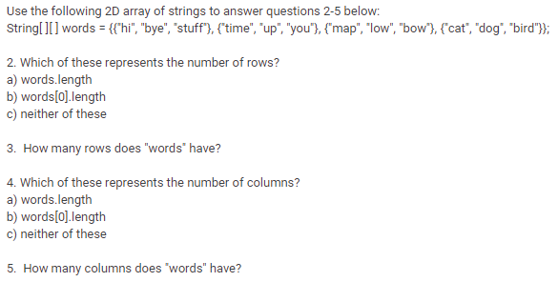
Warm Up!

Slide 5
Warm Up!

Slide 6
Warm Up!
4

Slide 7
Warm Up!
Each “row” has 3 “columns”
3

Slide 8
Coming Up
Today and week we return: Unit 8
Friday, March 3: 20pts major assessment, MC + FRQ Units 6, 7, 8
Week of March 6: Finish Unit 8 and launch next project
Up through May 17: Units 9 & 10, AP Exam Prep
Wednesday, May 17, 7:00am (hellooo Mr. alarm clock!): AP Exam
3 hours total: 90 min for 40 MC, 90 min for 4 FRQs
Post-AP: Interfaces, GUIs, web APIs, final project + presentation

Slide 9

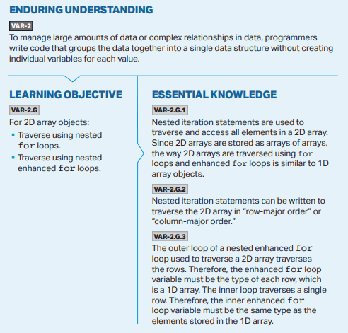
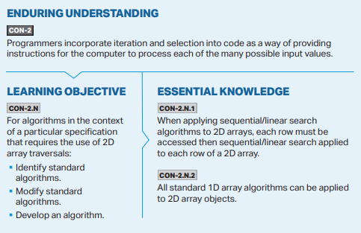
College Board Standards
Unit 8 Topic 2

Slide 10
Traversing 2D Arrays
Since 2D arrays are simply arrays of arrays, we traverse them the same way using for loops -- but for 2D arrays, we use nested for loops.
You can use standard, index-based for loops (if you need the indices of an element), or an enhanced for loop if you don’t need the indices.

Slide 11

Example: index-based for loops
int[][] numArray = {{1, 2, 3}, {4, 5, 6}};
for (int row = 0; row < numArray.length; row++)
{
for (int col = 0; col < numArray[0].length; col++)
{
System.out.println(numArray[row][col]);
}
}
Outer loop is rows
Inner loop is columns
Print each element by accessing it’s indices in the 2D array -- row then column (don’t forget RC Cola!)

Slide 12
Example: index-based for loops
int[][] numArray = {{1, 2, 3}, {4, 5, 6}};
for (int row = 0; row < numArray.length; row++)
{
for (int col = 0; col < numArray[0].length; col++)
{
System.out.println(numArray[row][col]);
}
}
Outer loop is rows
Inner loop is columns
Using the outer loop to iterate through the rows produces output grouped by row -- this is called traversing a 2D array in “row-major” order
Print each element by accessing it’s indices in the 2D array -- row then column (don’t forget RC Cola!)

Slide 13
Example: enhanced for loops
int[][] numArray = {{1, 2, 3}, {4, 5, 6}};
for (int[] row : numArray)
{
for (int element : row)
{
System.out.println(element);
}
}
Outer loop is rows; type of each element is array of ints: int[]
Inner loop is columns; type of each element is int
Print each element
If you don’t need the indices, enhanced for loops are preferred since they are cleaner and less error prone.

Slide 14
Example: enhanced for loops
int[][] numArray = {{1, 2, 3}, {4, 5, 6}};
for (int[] row : numArray)
{
for (int element : row)
{
System.out.println(element);
}
}
Outer loop is rows; type of each element is array of ints: int[]
Inner loop is columns; type of each element is int
Row-major order
Print each element
If you don’t need the indices, enhanced for loops are preferred since they are cleaner and less error prone.

Slide 15
What if we wanted to print by column?
How might we change this code so that we print the data by column instead of row? (i.e. traverse in column-major order)
Modify this code….
So this prints!
int[][] numArray = {{1, 2, 3}, {4, 5, 6}};
for (int row = 0; row < numArray.length; row++)
{
for (int col = 0; col < numArray[0].length; col++)
{
System.out.println(numArray[row][col]);
}
}

Slide 16
What if we wanted to print by column?
Swap outer and inner for loops so the outer loop goes through columns and inner loop goes through rows
This traverses the 2D array in column-major order!
int[][] numArray = {{1, 2, 3}, {4, 5, 6}};
for (int col = 0; col < numArray[0].length; col++)
{
for (int row = 0; row < numArray.length; row++)
{
System.out.println(numArray[row][col]);
}
}
SWAP!
Outer loop is now columns
Inner loop is now rows
We still print each element by accessing it’s indices in the 2D array -- row then column

Slide 17
Agenda
U8T2 Lab: Traversing 2D Arrays
U8T2 AP Practice Q's (6)
EC Opportunities:
U7T6 Explorations & Challenge
Movie Collection Extensions
Unit 7 Challenge Problem

